Slide 1
Brain Tumor Detection

Slide 2
Table of contents
1
Methodology
Introduction
2
3
Results

Slide 3
1
Introduction

Slide 4

Brain tumor detection is crucial for early diagnosis and treatment of brain-related diseases. Image processing techniques, including preprocessing, segmentation, feature extraction, and classification, along with machine learning and deep learning algorithms, can enhance early diagnosis and treatment planning. Integrating computer-aided diagnosis systems into clinical workflows can improve efficiency and reliability, leading to improved patient outcomes.

Slide 5
Methodology
2

Slide 6
The project focuses on developing an automated system for early detection of brain tumors in MRI images, with an emphasis on timely intervention for improved patient outcomes. The methodology follows a systematic approach:
Image Preprocessing:
Convert input image to grayscale.
Apply Gaussian filter for noise reduction and edge enhancement.
Utilize Otsu's thresholding to create a binary image.
Implement morphological closing for improved segmentation.
Feature Extraction:
Capture relevant parameters (area, perimeter, extent, axis lengths, solidity) from labeled image regions.
Store extracted features in one-dimensional arrays.

Slide 7
3. Tumor Detection:
Analyze extracted features to identify the presence of tumors.
Visualization:
Perform median filtering for noise reduction.
Apply Canny edge detection.
Create masks for tumor and non-tumor regions.
Draw contours on identified tumor regions using a yellow mask.
Overlay highlighted tumor regions on the original image.

Slide 8
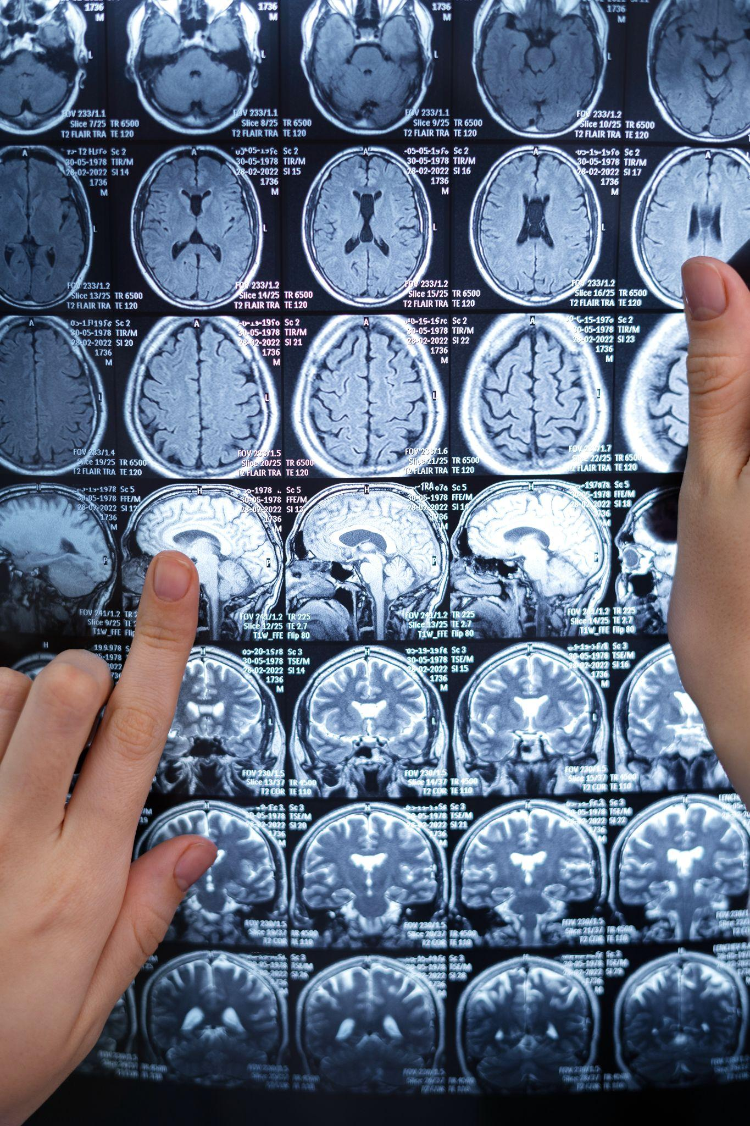
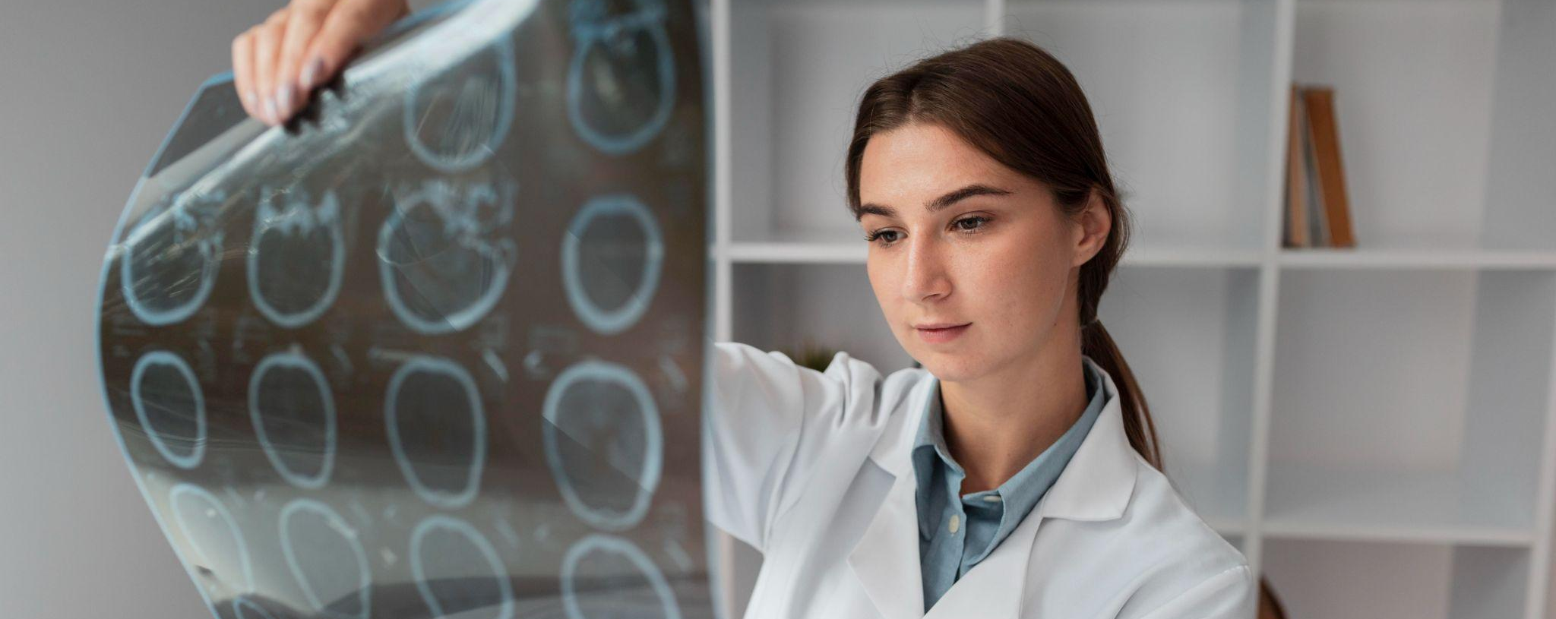
Results
3

Slide 9
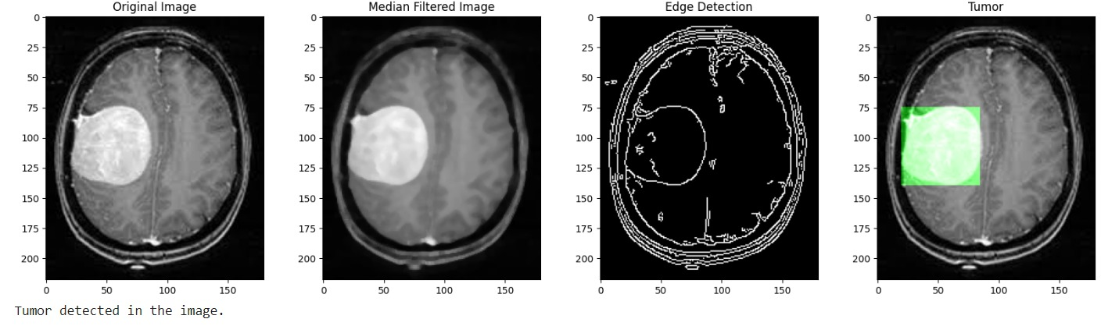
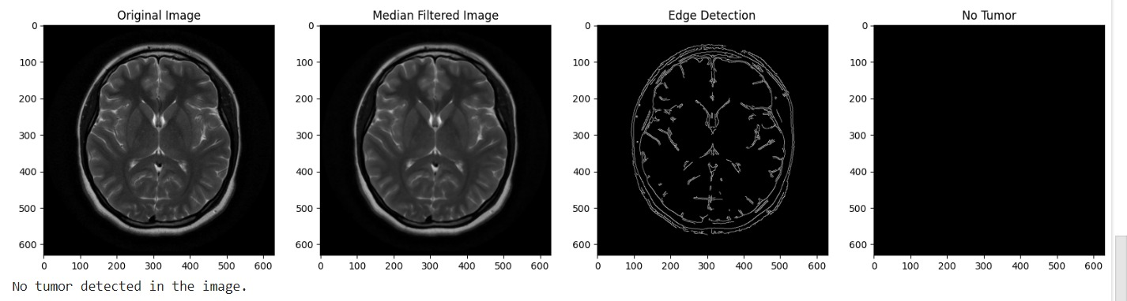
Final Display:
Present the original image.
Display the median filtered image.
Showcase edge detection results.
Present the image with highlighted tumors.
Fig(1): If there is a tumor detected
Fig(2): If there is no tumor detected

Slide 10
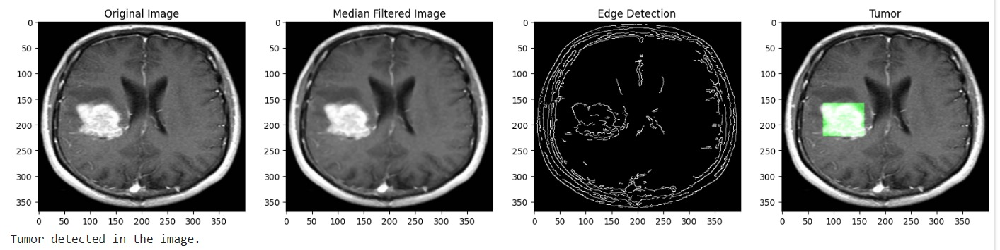
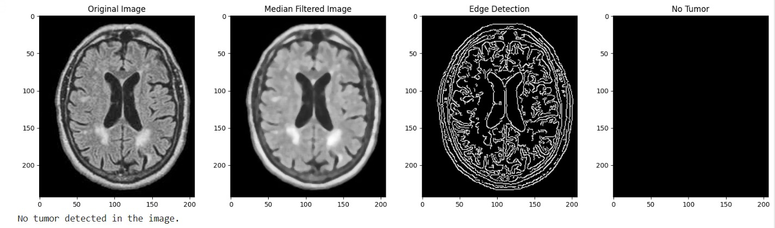
.
Fig(3): If there is a tumor detected
Fig(4): If there is no tumor detected

Slide 11
Thanks
Presented by
Youmna Tarek 202001016
Toka Mohamed 202002280
Reem Amin 202001495
Omnia Lotfy 202000350
Merna Mostafa 202002266

